Slide 1
Artificial Intelligence in Courts and Law Enforcement
Dr Anil Gore
Consultant Statistician
CYTEL
goreanil@gmail.com
Anil.gore@cytel.com
Jurimetrics is the application of
quantitative methods, probability and statistics,
to law

Slide 2
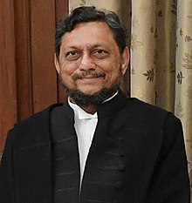
Chief Justice of India S A Bobade
January 12, 2020:
We have a possibility of developing Artificial Intelligence for the court system.
Only for the purpose of ensuring that the undue delay in justice is prevented.

Slide 3
Three ideas that led to this webinar series
Statistical and probabilistic thinking dovetails well with the court system
Data scientists and legal experts can together develop automation tools to expedite legal processes
Statistical thinking and analysis can be useful in crime investigation

Slide 4
AI :Why & How
Why? Reduce case backlog
Improve access to court system
Improve productivity, reduce cost
Others already much ahead (US, UK, China etc.)
How? Collaboration between statistics/data science and legal profession (Model: Stanford Codex- Center for Law and Informatics, International Conference on AI and Law)
Instead of being afraid of each other, let us complement each other.

Slide 5
What is Artificial Intelligence?
AI :Getting a computer to behave in a way we call “intelligent” when done by humans.
Google Translate
‘DeepTag’ an AI tool examines your face (picture) and grades it for acne, wrinkles etc.
‘DeepTek’ reads medical images and gives diagnosis
In the legal sphere?
COMPAS assesses the risk that a given accused will abscond and repeat offence if granted bail
PredPol predicts place, time and crime type in a city, so police can plan effective patrolling

Slide 6

Turing test (Alan Turing, father of AI)
When should you call a machine ‘intelligent’?
if a human interrogator could not
tell it apart, through conversation,
from a human being
Two different rooms
You ask questions and get answers from the other room
Is it a machine? CAPTCHA test wants to avoid machines

Slide 7
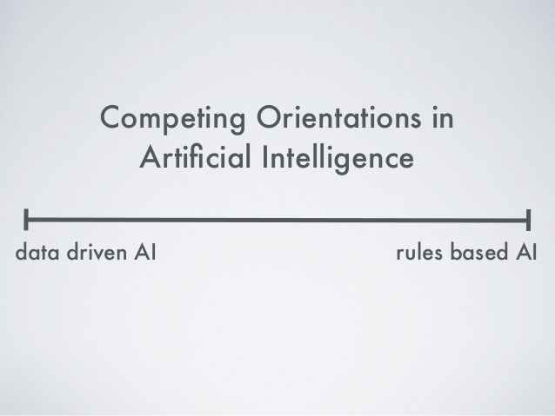
Two kinds of AI
Excel, Minitab and other packages are also AI
But rule based
Step by step instructions given
Chess playing, facial recognition etc. not rule based
Data driven
They face different challenges

Slide 8
Which legal things are easy for machines?
Accept documents electronically [and complaints]
Search cases like the ongoing one
Update cases handled by a lawyer (https://angel.co/company/provakil-technologies)
remind clients of delivery of important files and procedural steps
https://www.ncjrs.gov/pdffiles1/Digitization/174915NCJRS.pdf
Income tax calculations routinely done : Taxpro,
GST calculations: Cleartax , Legalraasta
All rule based, step-by-step instructions

Slide 9
Tasks not easy
Law document translation system :quality translation with speed can improve the efficiency of the Indian Judicial System.
‘SUVAS’ (Supreme Court Vidhik Anuvaad Software)-translates judgments from English to Indian languages (came this year?)
Students of Law, Statistics, Computer Science should take up testing of this software as project and comparison with google translate to produce ideas for improvement.

Slide 10
https://www.youtube.com/watch?v=iAsOq-tAe_s
A law professor on deciding if a movie review is good (+ve) or bad. Nice example of AI. So I better tell you in detail.
https://www.youtube.com/watch?v=p-82YeUPQh0
About AI for estimating risk score to decide about bail. High risk, no bail. popular AI tool is biased. We will see this also in detail

Slide 11
Let us get into the guts of AI
AI for movie reviews
Netflix recommends us movies keeping in mind what we watched (data driven prediction)
‘Reasonable’ methods not as good as data driven learning
Step 1: object- classify published movie reviews as good or bad (favorable or unfavorable) and cross check with humans
Step 2: logic- we can identify signal words in reviews and use them

Slide 12
Classification of Movie Reviews by computers
Problem: Take a bunch of reviews. Write program to decide if favorable or not.
Reasonable strategy: we can identify which words in reviews indicate ‘good’. Use them.
Let computer do the selection
Good | Unfavorable
Human judgement
Brilliant | sucks
dazzling | cliched
cool | slow
gripping | bad
moving
60% success
Good | Unfavorable
(many stars) | (few stars)
still | Bad
love | Stupid
superb | Worst
great
95% success
Using our own choice of words takes us to low success rate (like coin tossing)
Better let the computer learn from data rather than our judgment

Slide 13
Now let us take a legal problem
Problem selected: automating bail decisions
Not really. We don’t replace judge. Just assist.
Compute risk of absconding or repeat offence if given bail
If risk high refuse bail
If risk low grant bail
Judge can overrule (generally does not)
AI reduces his headache

Slide 14
How to check if the AI is doing a good job?
Take some old cases and calculate risk using software
Check what happened after that
If calculated risk was high and person did commit crime, then that is good guess
Count good guesses and bad guesses
False +ve (calculated high risk but person behaved well)
False -ve (calculated low risk but jumped bail)
Both false + and – should be rare

Slide 15
Correctional Offender Management Profiles for Alternative Sanctions (COMPAS). (a private company AI)
https://www.researchgate.net/publication/321528262_Correctional_Offender_Management_Profiles_for_Alternative_Sanctions_COMPAS
examines the predictive validity of the COMPAS risk scales by fitting Cox proportional hazards models to recidivism outcomes in a sample of presentence investigation and probation intake cases (N=2,328). Results indicate that the predictive validities for the COMPAS recidivism risk model, as assessed by the area under the receiver operating characteristic curve (AUC), is reasonable.

Slide 16
COMPAS
Mr. Bob Wessels, the Criminal Courts Manager of Harris County, Texas. "You don't want to find out after a bail hearing that someone walked out the door with three prior convictions.“
The bias in COMPASS seems to let this happen

Slide 17
Bias in AI(COMPAS) for risk factor estimation
Defendant race | False positive | False negative
Black | 45% | 28%
white | 24% | 48%
https://www.propublica.org/article/
machine-bias-risk-assessments-in-criminal-
sentencing
(about problems of bias with AI software to predict future behavior)
Gives examples of how risk scores were utterly wrong
Two people each committed petty theft
Black- first time offender,
white- history of armed robbery .
AI gives higher risk for black person.

Slide 18
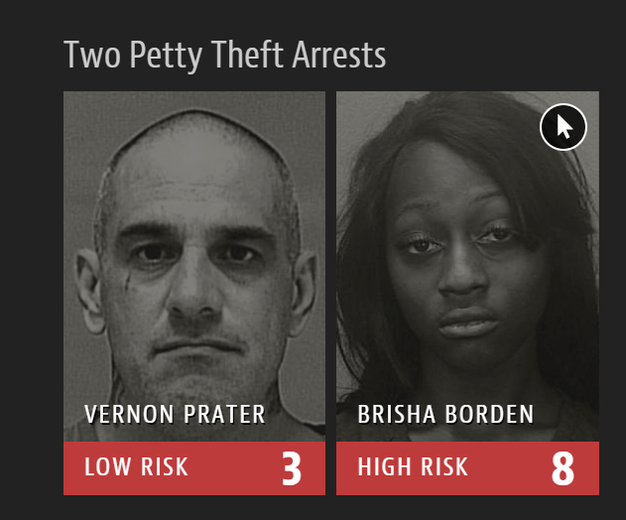
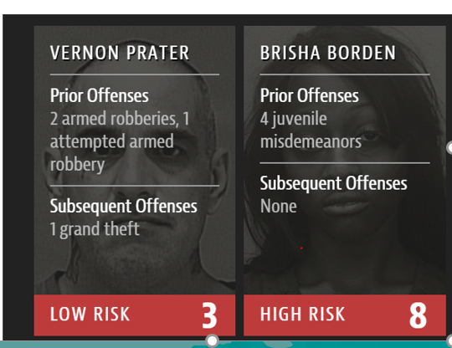
Gross error by AI in two minor offenses
Take a child bike
for free ride
2.Shop lifting $90 worth
tools

Slide 19
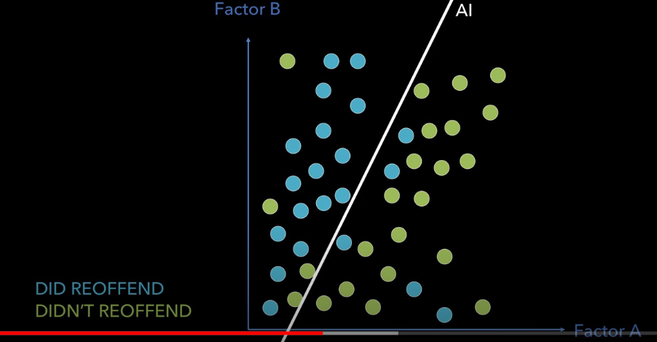
A simple classifier
Typically info on 7 variables
Age , sex, 5 measures of crime history
Try many combinations of many factors to check risk classification
Age and # of past crimes does well
67%success (as good as AI) but also biased
Algorithms do not know race. Then why bias?
In NY blacks are 15 times as likely to be arrested For minor marijuana charge.
So data are biased.

Slide 20
Judges are human (biased sometimes)
There's plenty of evidence of all kinds of human bias built into justice systems. In 2011, for instance, a study of an Israeli parole board showed that the parole board
delivered harsher decisions
in the hour before lunch and the hour before the end of the day.

Slide 21
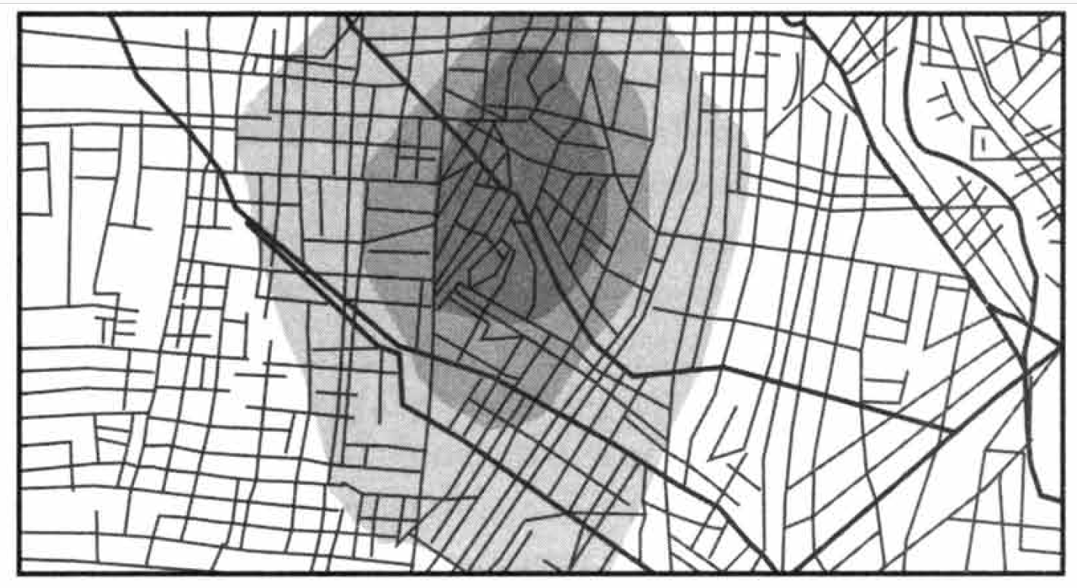
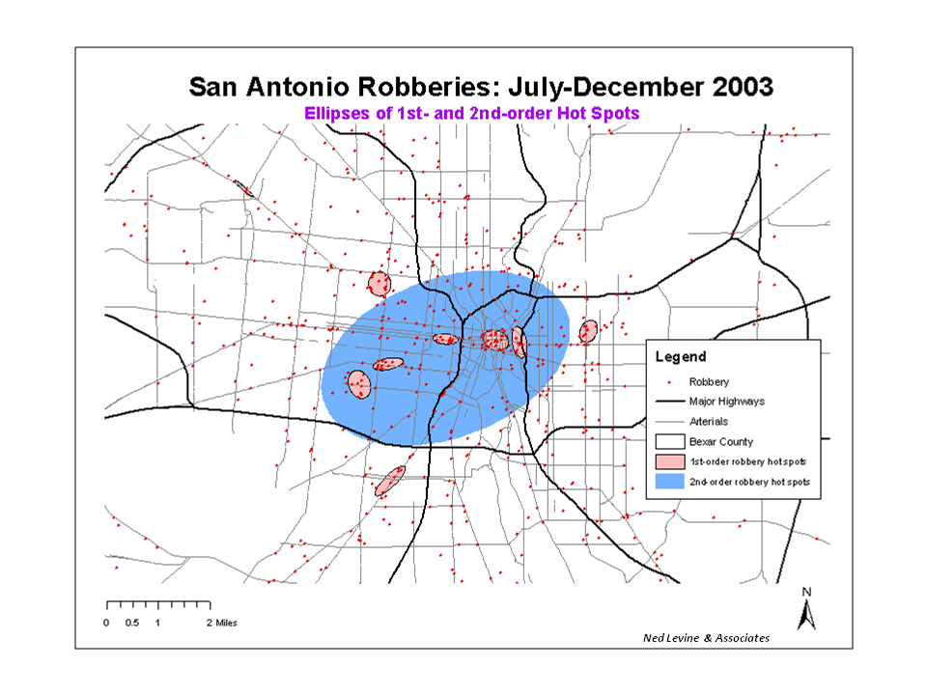
Some AI tools for law enforcement
1. Rigel 2.Clear 3.CrimeStat 4.Dragnet
Show Hot spots [in the map] where chance of finding the criminal is high
Predict time and place in the city when/where crime will happen
Shows likely residence of
serial rapist (Rigel)
Shows robbery hotspots (CrimeStat)

Slide 22
Elementary Statistical Analysis
You do not always need sophisticated AI tools.
Good basic statistical analysis can also help in crime investigation.
Let us consider one illustration.

Slide 23
United States v. Kristen Gilbert.
The nurse known for anticipating heart attacks
Gave epinephrine as emergency medicine while waiting for doctor
Suspicion- gave epinephrine to induce heart attack , her ward seemed to have a higher rate of heart attack
Really? Enough to file a case?
No direct evidence

Slide 24
Statistical analysis
Stephen Gehlbach of the University of Massachusetts did analysis (1998)
http://www.stat.ucla.edu/~nchristo/statistics100B/article.pdf
Has to analyze and convince the jury who are not statisticians
Arguments must be simple and convincing

Slide 25
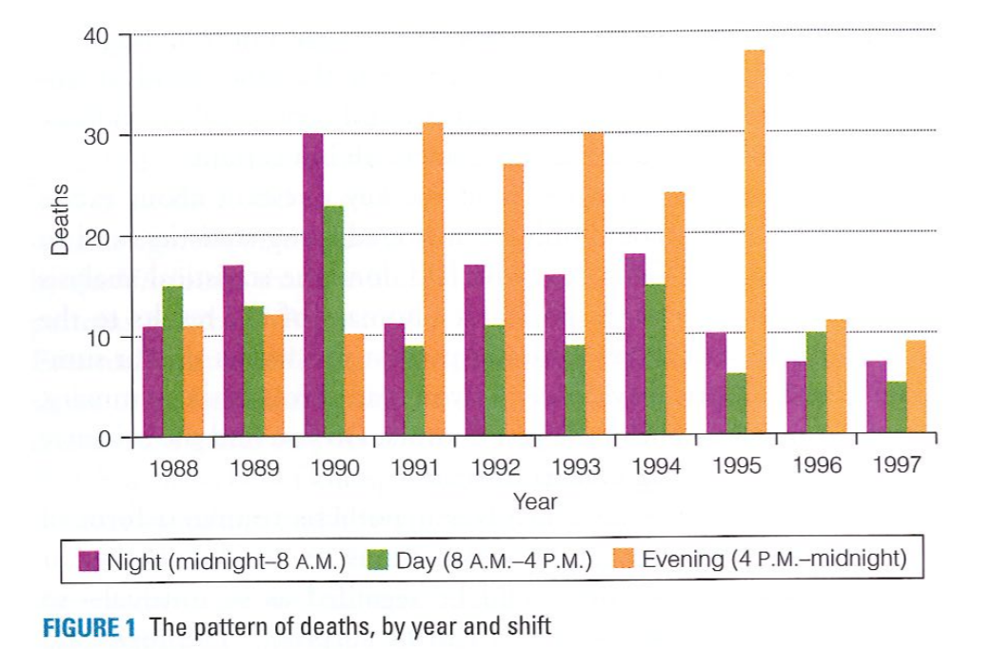
Patterns of deaths over years
Ms. Gilbert worked from
1990 to 1995
1990 exceptional. Many deaths in
night shift. Otherwise evening shift
91-95 Ms. Gilbert moves to
evening shift
In 1990 Gilbert gets night shift

Slide 26
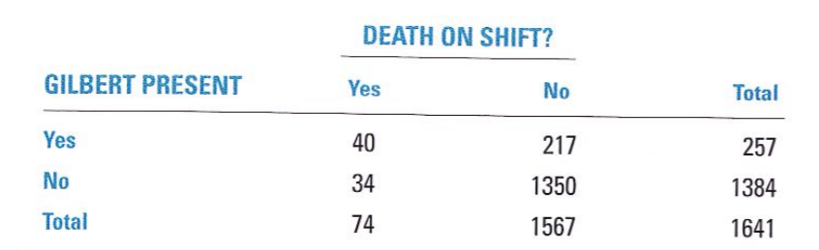
Is all this due to chance?
40 deaths when Gilbert is present is too large a count
Chi-square test very highly significant p<.001

Slide 27
Let us do it right here
Indians are very capable in the field of statistics and IT
This college has shown tremendous promise in some fields
They have a small media training department
It produced Nagnath Manjule who directed ‘Sairat’
So the teachers and students of Statistics and Computer Science can build automation tools and AI tools for courts and police

Slide 28
Automation agenda
Bring automation to lower courts
Rojnama (updating case record)
Teach staff use of voice-to-text
Stay orders, Injunctions
Heir on record
Amendment application
Adjournment application
E filing in civil court

Slide 29
Proposal for Law Colleges
You can contribute to reducing burden on the courts.
Learn use of ODR (online dispute resolution) platforms. Launch a certificate course.
Supreme Court & NITI Ayog in favor.
Start a ODR service center for people around you.
Great experience for your students.
Partner with Tech industry (providers of ODR platform)

Slide 30
Our review so far
Lawyers must identify problems in courts for which automation will be useful
Then joint teams of lawyers and data scientists to be formed to develop a tool such as expert system
Rule based AI easier to build and you can start small
Data based AI more difficult, but India has enough capability in its academic groups and IT companies
Development has to be need based and driven by our local conditions
AI are not really off the shelf purchase items
You have to nurture them

Slide 31
Remaining topics
UK and China
Indian start ups in Legal AI space
Predictive policing
Predicting court decisions (Fantasyscotus.net)
Will go as far as time permits

Slide 32
China
The three AI Internet Courts in China(Hangzhou, Beijing and Guangzhou) judge disputes relating to online transactions of sale of goods and services, copyright and trademark, ownership, trade disputes etc. Started in 2017. Operate 24 hours a day and 7 days a week.
The average duration of these online trials in Hangzhou was 28 minutes, and the average processing period from filing to trial and conclusion by a verdict was 38 days
Evidence is based on block chain data in online court
(https://www.youtube.com/watch?v=QkczNbGxvN4)
Count of cases settled is in millions

Slide 33
AI in court- China
https://www.barandbench.com/columns/is-artificial-intelligence-replacing-judging
https://www.worldgovernmentsummit.org/observer/articles/could-an-ai-ever-replace-a-judge-in-court
Xiaofa is a robot in Beijing No 1 Intermediate People’s Court. She knows the answer to more than 40,000 litigation questions and can deal with 30,000 legal issues
more than 100 robots in courts in China
An application named Intelligent Trial 1.0 is used in hundreds of courts

Slide 34
Private sector startups in India
Prarambh, the legal tech incubator founded by India's largest law firm, Cyril Amarchand Mangaldas
First round winners out of 51 (to be mentored by CAM)
Law community’s help needed for startups to develop suitable solutions

Slide 35
Some legal tech start ups in India
Legalraasta Tech Pvt Ltd: helps in compliance with government rules
https://www.spotdraft.com/ : create , manage and review contracts
https://www.myadvo.in/ : RERA, NCLT, Mutual consent divorce, trademark registration, check bounce
https://legalkart.com/ online legal consultation
https://lawrato.com/ free legal advice online

Slide 36
Indian ODR startups
Nestaway Technologies: startup for renting places
Disputes- rent not paid
Centre for Alternate Dispute Resolution Excellence. founded by Shalini Saxena and Kanchan Gupta
Sama, a startup by Pranjal Sinha, Akshetha Ashok and Vikram Kumar, is running a pilot for ICICI Bank. It is helping resolve nearly 10,000 disputes with values of up to Rs 20 lakh after winning an E-Alternate Dispute Resolution Challenge 2019 launched by the bank and Agami, a non-profit.
https://www.presolv360.com/ for out of court resolution on internet

Slide 37
Deficiency of Private sector initiatives
All for profit
Not about increasing efficiency of court system
Not useful for clearing backlog of cases
The AI development we have in mind has to be from non-profit initiative

Slide 38
Predictive Policing
Anticipate criminal activity using mathematical, predictive, and analytical techniques. Los Angeles Police Department (LAPD) predict where crime might occur; direct scarce resources to such locations. Risk: algorithms flawed and reinforce racial bias
Pathological numerophobia among lawyers (among many groups). What about police?
Will algorithms be able to predict trial outcomes?

Slide 39
US City Police Departments (LA, NO etc.)
https://www.youtube.com/watch?v=kTIVIok4jT8
https://www.youtube.com/watch?v=FC-OHhTG2sk
https://www.youtube.com/watch?v=7Ly7yAzLDjA
https://www.youtube.com/watch?v=UQcEU0fK_BY
https://www.youtube.com/watch?v=U0gX_z0V0nE
https://www.youtube.com/watch?v=Gi4YeRqfb24
https://www.youtube.com/watch?v=rolFHPegLVQ
https://www.youtube.com/watch?v=5hKWLY1lZrs
(briefly describe pred pol etc. Based on assumption of clustering of crimes , in space and time) burglary, car theft, one successful theft encourages another

Slide 40
Palantir Technologies
New Orleans PD program traced people’s ties to other gang members, outlined criminal histories, analyzed social media, and calculated the likelihood that individuals would commit violence or become victims (software by Palantir)
Specify area of city, specify time window (say third shift of March 1, 2020) specify crime type

Slide 41
Final Slide
It is possible for data scientists to work with Judges, Lawyers and Police to improve performance of our law enforcement systems and courts.
Necessary tools can and should be developed in the country.
Grass root level work is needed if problems faced by people are to be reduced

